Slide 1
CMAC 3990.200
Systems Administration and Operations
Fall 2025 – Week 2.1 – September 2nd, 2025
Network & Command Line, Cloud Intro
Domain Name Systems

Slide 2

Objectives
Weekly Info
SSH Tunnel & Proxy
Assignment 2
Server connectivity and HA
Storage
Trends
Linux Commands
AWS Intro
DNS Overview
  Commands
  IPv4/IPv6
  A, AAAA, NS, etc. Records
DNS Installation
  Caching
  Recursive
  Authoritative

Slide 3

Weekly Info
“It is the capacity to develop and improve their skills that distinguishes leaders from followers.”
–Bennis and Nannus
Attendance
Good of the class
Assignment 1 due Wednesday!
Assignment 2 due Friday!
VPN Nonsense…

Slide 4

SSH
SSH – Secure Shell
  Creates an encrypted terminal connection to a server shell
  Allows for other types of communication to be tunneled through connection
    Tunneling insecure information through a secure tunnel creates a secure connection!
  In Windows, you can use the program Putty to
  SSH in to a server
  In Linux/MacOS, you can run the SSH command
  directly from the command line
  Command format:
    ssh –L portX:host:portY –D portZ user@host
    ssh –L 5901:hostname.fqdn.com:5901 –D 56565 user@hostname.tld
    -L: forward local portX to remote host portY
    -D: forward web requests through SOCKS proxy on portZ

Slide 5
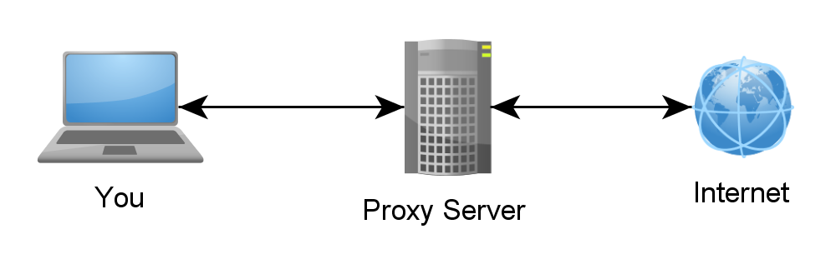
SSH Tunnels
SSH Tunnels are secure and encrypted between endpoints!
Local port forwarding
  Similar to port forwarding on a router
  ssh –L source_port:destination_host:destination_port user@host.tld
    Ex: ssh -p 54321 cs_student@jpatalon.cs.edinboro.edu -D 55509 -L 55909:147.64.242.113:55909
    This command opens an encrypted tunnel between my local machine and ssh server jpatalon.cs.edinboro.edu
    Traffic sent to localhost port 55909 is redirected to 147.64.242.113 port 55909

Slide 6
SSH Tunnels
SOCKS (Dynamic) Proxy
  Allows for website proxying
  Can be used to allow connections around firewalls
    Connect to your cmac3990 web server from anywhere in the world through an intermediate host!
  ssh –D port user@host.tld
    Ex: ssh -p 54321 cs_student@jpatalon.cs.edinboro.edu -D 55509 -L 55909:147.64.242.113:55909
    This command opens an encrypted tunnel between my local machine and ssh server jpatalon.cs.edinboro.edu
    Web SOCKS traffic is sent through port 55509 to server jpatalon.cs.edinboro.edu, where it is then forwarded to the destination

Slide 7
Web Browser SOCKS Proxy Config
Firefox Example
  Extremely easy to set, others more difficult
Open SSH tunnel with dynamic port forwarding to my server using our shared creds
  Ex: ssh -p 54321 -D 555## cs_student@jpatalon.cs.edinboro.edu
You can also create a putty shortcut in Windows, append to the end:
  Ex: ssh.exe -p 54321 -D 555## cs_student@jpatalon.cs.edinboro.edu
Log in with the shared SSH credentials
Launch Firefox

Slide 8
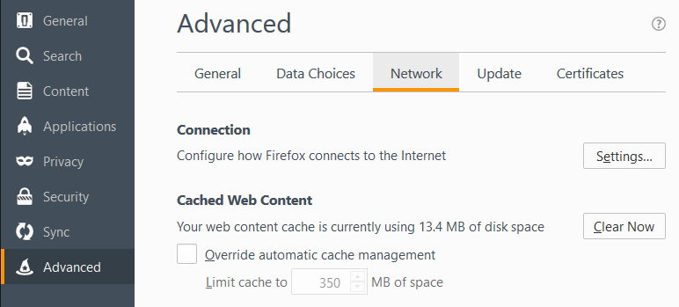
Web Browser Proxy Config
Exact steps may differ depending on version
  Options
  Advanced
  Network Tab
  Settings…

Slide 9
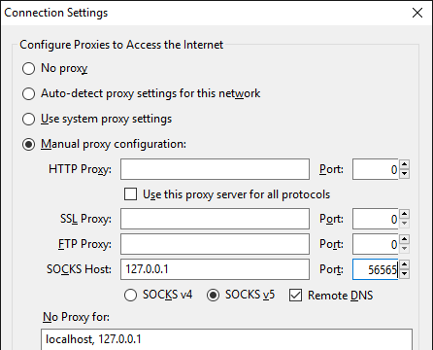
Web Browser Proxy Config
Exact steps may differ depending on version…
  Options
  Advanced
  Network Tab
  Settings…
    Manual Proxy Configuration
    SOCKS Host: 127.0.0.1
    Port: 555## (56565 in picture)
    Socks v5
    Remote DNS
    No proxy for
      localhost, 127.0.0.1

Slide 10
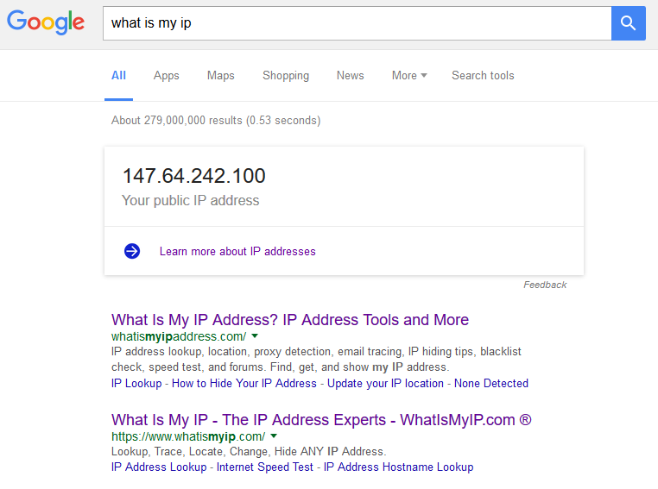
Web Browser Proxy Config
Test by opening a web page, and visit a website that will tell you your IP
  https://whatismyip.com
  Type in to google “What is my ip”
  Multiple servers with multiple ports
    Open multiple connections on different ports
    Switch ports to quickly switch proxy endpoint
  Compare to same search in a different browser
    If you are on the same network as the server you’re
    proxying through, and some sort of NAT is involved,
    it might not actually be different…

Slide 11

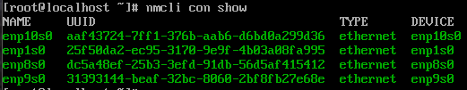
Assignment 2
Log in to your VM’s OOB console using Virtual Network Computing (VNC)
  VNC OOB: csvm1.cs.edinboro.edu:559## (01-25)
    If using SSH connection, you must forward the correct port and connect with VNC to localhost:559## !!!
  Either connect to the CS VPN, or open an SSH tunnel to forward the proper port!
    ssh -p 54321 cs_student@jpatalon.cs.edinboro.edu -D 555## -L 559##:147.64.242.113:559##
      Connect to localhost port 559## via VNC! (RealVNC Viewer?)
      Login creds are in credentials.txt file!
Set up your network connection
  View network connections with nmcli con show
  We want to configure device enp1s0!

Slide 12
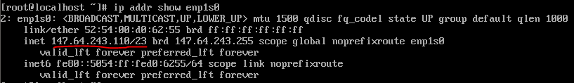
Assignment 2
Set up your network connection
  We want to configure device enp1s0!
    nmcli con down enp1s0
    nmcli con mod enp1s0 ipv4.method manual ipv4.addresses 147.64.243.1##/23
    nmcli con mod enp1s0 ipv4.gateway 147.64.242.1
    nmcli con mod enp1s0 ipv4.dns "8.8.8.8,8.8.4.4"
    nmcli con up enp1s0
    ip addr show enp1s0

Slide 13
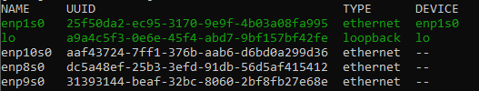
Assignment 2
Set up your network connection
  Disable all the other interfaces:
    nmcli con mod enp8s0 connection.autoconnect no
    nmcli con down enp8s0
    nmcli con mod enp9s0 connection.autoconnect no
    nmcli con down enp9s0
    nmcli con mod enp10s0 connection.autoconnect no
    nmcli con down enp10s0
    nmcli con show

Slide 14
Assignment 2
Change the root password!
  Make sure you don’t forget it!
  passwd root
Set the local machine hostname!
  hostnamectl set-hostname cmac3990-1##.cs.edinboro.edu
Update your system
  dnf update
Install some additional software with dnf
  dnf install bind-utils nano net-tools sendmail s-nail wget
Create SSH key as root (accept all defaults!)
  ssh-keygen

Slide 15
Assignment 2
Import professors public SSH key into your root accounts authorized_keys file
  curl https://jpatalon.cs.edinboro.edu/cmac3990/classfiles/root@cmac3990-110.pubkey >> /root/.ssh/authorized_keys
  Make sure permissions on authorized_keys file is correct!
    chmod 600 /root/.ssh/authorized_keys
Add user account named “user” and a user account for yourself
  useradd user
  useradd accountname
Set the passwords for the user account and your new account
  passwd user
  passwd accountname
Start and enable sendmail for assignment submissions!
  systemctl enable sendmail --now

Slide 16
Assignment 2
Give your user account sudo
  Create a new file for this at /etc/sudoers.d/users
    accountname ALL=(ALL) ALL
Disable SSH root password login
  Only allow root user SSH key based login
    Edit the /etc/ssh/sshd_config file and uncomment the line:
      PermitRootLogin prohibit-password
Update and reboot your system
  dnf update
  reboot
Validate you can still log in after rebooting!
  You must log in as your new accountname instead of root!
Run professor’s check script!
  https://jpatalon.cs.edinboro.edu/cmac3990/classfiles/assignment2check.sh
  Due Friday September 5th, 2025
    Submit by the end of the day!
Don’t forget the documentation!

Slide 17
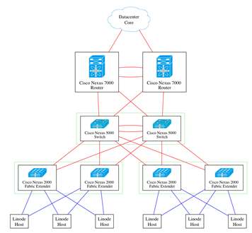
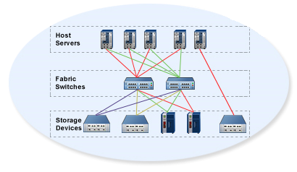
Server Connections
Ethernet Network
  Multiple interfaces provide redundancy
  Active/Backup or Active/Active
  1-10+ GBps
Storage Area Network
  Separate physical network
  Redundancy
  Connection between server and disk
  4-8+ GBps

Slide 18
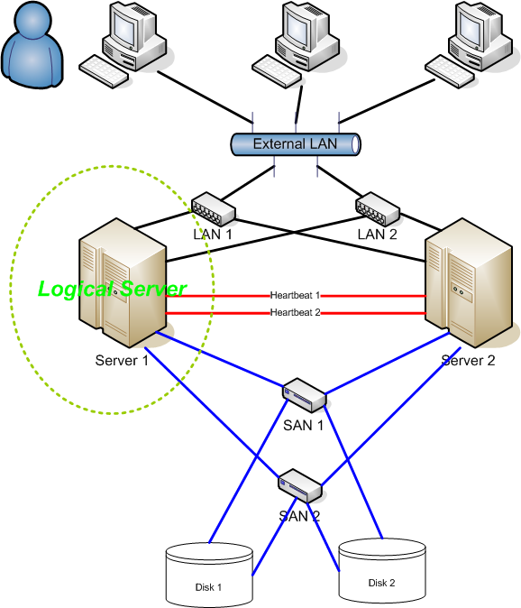
High Availability
High Availability (HA) refers to the availability of resources in a computer system, in the wake of component failures in the system.
HA is a characteristic of a system
HA Systems feature several key items:
  Elimination of single points of failure
  Reliable components
  Failure detection
HA is generally measured by unscheduled downtime
Fault Domain

Slide 19
High Availability
HA is measured by downtime
  Scheduled downtime
    System patches or configuration changes requiring a reboot
    Logical, scheduled, approved events
  Unscheduled downtime
    Internal or external hardware or software failure
    Natural disaster, security breach
Availability is usually measured as a percentage
  Percentage of minutes per year a system is online
  99.999% - Five Nines – 5.26 minutes (5:16) of downtime per year
May be measured and interpreted multiple ways

Slide 20
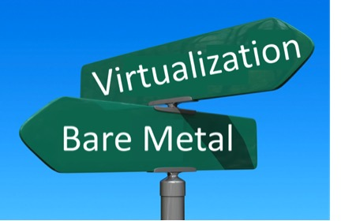
Trends
Hardware Virtualization
  A virtual machine acts just like a physical machine with a real operating system
  Only virtualization platforms should be installed on physical servers where possible
  Host, Guest
  Benefits: snapshots, failover, migration
Desktop Virtualization
  Thin clients
  Allows for easier, centralized management
  Lower total cost of ownership (TCO)
  Virtual Desktop Infrastructure (VDI)

Slide 21
Trends
Operating System Virtualization
  Allows multiple isolated applications
  Containers, chroot jail, etc.
Service Virtualization
  Emulate services for testing, without real data
Memory Virtualization
  Aggregate RAM from multiple hosts into a shared pool
  Swap files (virtual memory, page files)
Storage Virtualization
  Aggregate multiple hard disks into a single storage pool

Slide 22
Trends
Network Virtualization
  Create the appearance of separate networks on the same physical cable or interface
  Virtual Local Area Network (VLAN)
  Virtual Internet Protocol address (VIP)
Emulation
  Application that emulates the hardware functions of another
  piece of hardware
  Video game console emulators
Nested Virtualization
  A virtual machine within a virtual machine
  Inception

Slide 23
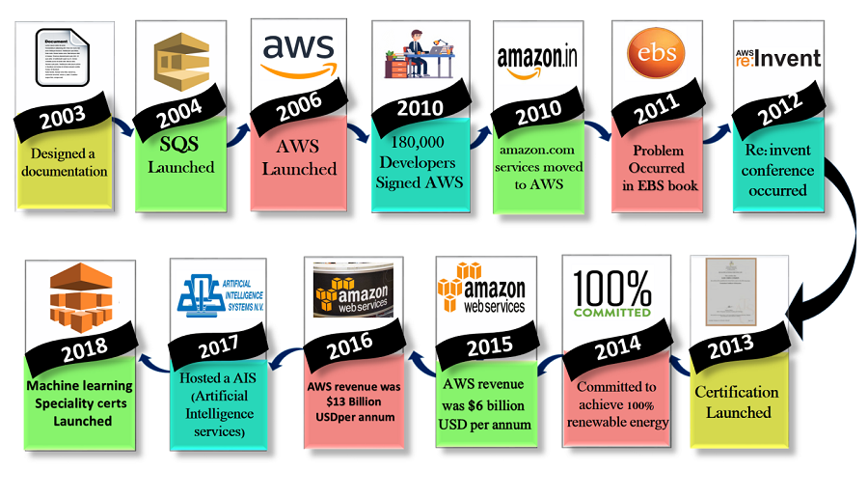
Intro to AWS
Launched in July 2002, Re-Launched in March 2006
Categories of services
  Developer services
    App services, mobile services
  Core infrastructure services
    Compute, Network & CDN, Storage, Database
Instance build GUI walkthrough
Auto scaling, launch configs, load balancer…
Marketplace

Slide 24
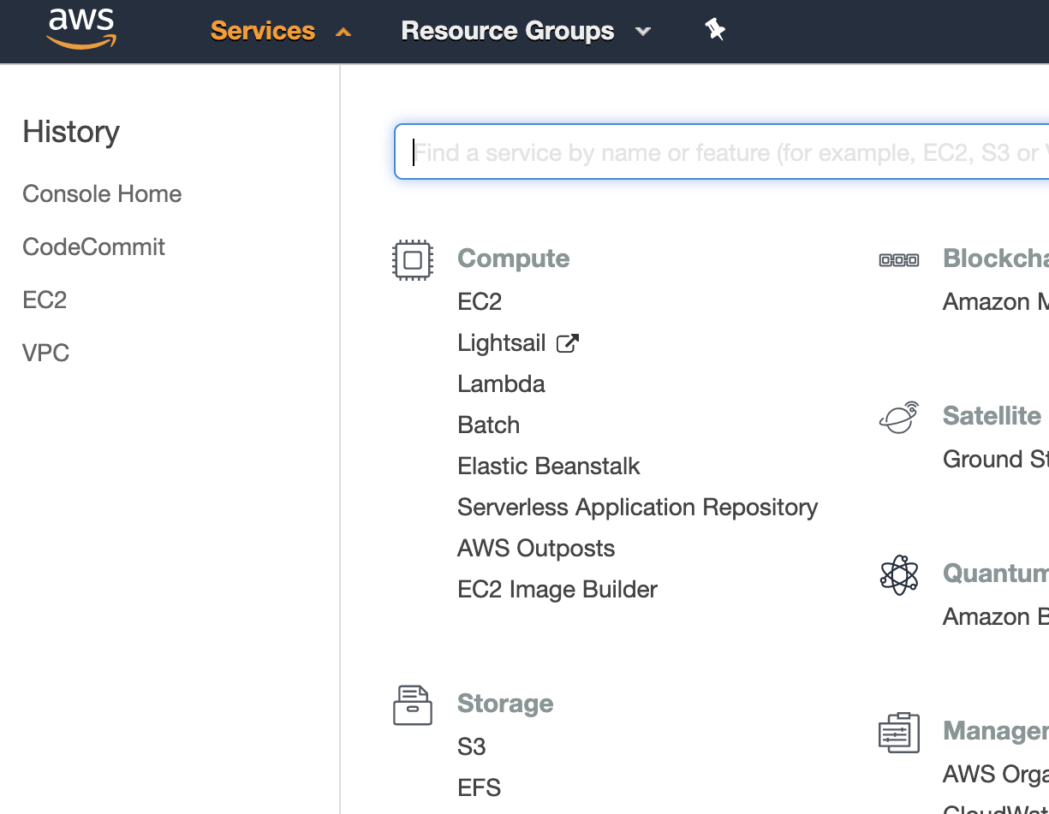
Accessing AWS
AWS SDK’s
  Android, Javascript, iOS, Java, PHP, Python, Ruby, IDE Toolkits, more…
Third Party Tools / Commercial Options
  Asgard from Netflix, Web browser plug-ins, etc…
AWS Mobile Applications
  Console management apps for Android and iOS
AWS Management Console
  Web GUI
AWS CLI
  Windows Powershell/Linux CLI
API’s
  HTTP/HTTPS Web Calls

Slide 25
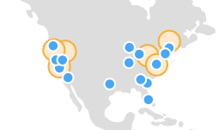
Regions and AZ’s
Regions – Independent collections of data centers within a specific geographic area
  US East 1 – Northern Virginia
  US East 2 – Ohio
  US West 1 – Northern California
  US West 2 – Oregon
  Different API endpoints and such!
  Cloudping.info
  Not every service is available in every region
Availability Zone – A data center within a region
  us-east-2a
  Low latency connections between regions

Slide 26

AWS Account
Team based accounts
  Dev, test, prod, etc
Application based accounts
  Billing, FarmVille, Facebook Messenger, Portal
AWS Consolidated Billing
Not every AZ is the same for each account!
  My account’s us-east-1a AZ might be different than yours!
  Balance!
Service Limits
  Prevent crazy runaway processes, or excessive use of resources

Slide 27
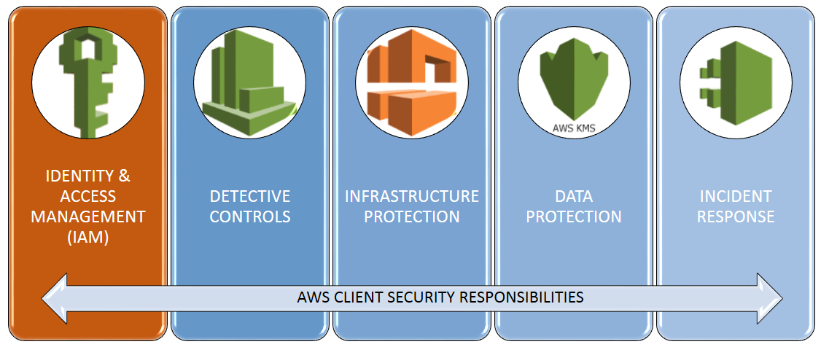
AWS Shared Security Model
The responsibility is different depending on the service!
  Who does patching?
  Who does backups?
  Got root?
What parts of security you manage
  Uhh, your password?
  Account access
  Network access
  ACLs, routing policies, security groups
What parts of security AWS manages
  Physical Data Centers
  Applications as services

Slide 28
AWS Tools and Use Cases
New Applications
  ”Green-field”
Backups, Recovery, Disaster Recovery
  Cold, warm, hot sites
Content Delivery Network (CDN)
  Optimize user response times!
Computationally intense tasks
  It can be expensive to purchase and maintain
  high-performance equipment
  100 hours on 10 VM’s is roughly the same cost as
  1 hour on 1000 VM’s!

Slide 29

Compute
Brains and processing power
CPU/RAM
Server in a data center
Full VM (or physical machine) dedicated to you
  Tons of different sizes and shapes
  Optimize for your workload
Temporary code execution on a non-dedicated machine
  Serverless Computing
EC2 – Elastic Compute Cloud
ECS – Elastic Container Service
ECR – Elastic Container Registry
EKS – Elastic Kubernetes Service
AWS Elastic Beanstalk
AWS Lambda
AWS Batch
AWS Lightsail

Slide 30
Elastic Compute Cloud (EC2)
EC2 – A virtual machine within your virtual AWS environment
  Amazon Machine Images (AMI’s)
    Template used to build a new server
    Create your own
    Marketplace, Community
  Instance Types
    Color, size, and shape of turtle (CPU/RAM/Network/Turbo/etc)
    Micro, General Purpose, Compute Optimized, GPU, FPGA, Memory, Storage
  Purchasing Options
    On-Demand
    Reserve 1+ years – Pay more up front for a better discount
    Scheduled – Reoccuring Schedule
    Spot – Unused resources – priced based on supply and demand
      Can be terminated with only a 2 minute warning.
    Reservations – Reserve capacity for a time

Slide 31
Elastic Compute Cloud (EC2)
EC2 – A virtual machine within your virtual AWS environment
  Tenancy – Where your VM actually runs
    Shared, Dedicated Instances, Dedicated Hosts
  User Data – Startup scripts
    Install tings automagically
  Storage
    Persistent Storage – EBS Volumes
      Separate from your instance, network connected, think “D:\” drive or a network NAS drive
      Attach/Detach, Encryption, snapshots, compression, replication…
    Ephemeral Storage – OS volumes
      Physically connected to the host, data lost when instance is terminated, cannot detach
  Security
    Security Group – A firewall for your EC2 Instance – Ports, protocols, sources, destinations…
    Key Pairs – Public/Private key used for authentication – AWS keeps public key, you keep private key
    It is your responsibility to maintain OS or application security and updates!

Slide 32
EC2 Container Service (ECS)
Run Docker enabled apps without a full VM/OS
Underlying Docker services are abstracted – they are managed and maintained by Amazon
Container apps are decoupled from the underlying OS, providing many benefits
Managing a Docker cluster can be costly and time consuming
Fargate Launch Mode
  Specify CPU, memory, network, security, and your Docker application images
  Amazon manages the rest
EC2 Launch Mode
  You are responsible for maintaining the underlying OS, scaling, and specifying the instance type

Slide 33
EC2 Container Service (ECS)
A ECS cluster ins comprised of a collection of EC2 instances
Security groups, auto scaling, and load balancing can be defined
Similar operation to EC2 instances
Clusters act as a resource pool
Clusters can dynamically scale
  You can only scale within a region
Scheduled deployment options
Docker and ECS agents to control

Slide 34
Elastic Container Registry (ECR)
Provides a secure location to store and manage your Docker images, fully managed by Amazon
Registry
  Host, store, and create image repos
Authorization Token
  Use aws and docker login commands to get auth token
Repository
  A place to store your Dockers
  You can have multiple repos for multiple Docker collections
Policy
  Resource based access policies – who can do what
Image
  Docker package

Slide 35
ECS for Kubernetes (EKS)
Kubernetes – A production grade open-source container-orchestration system for automating application deployment, scaling, and management.
EKS – A managed service allowing you to run Kubernetes across your AWS infrastructure
  The control plane is where you control the cluster containers from!
    Tracks containers, manages container clusters, schedules jobs
  AWS manages the control plane
Worker nodes – A machine in Kubernetes
  Provisioned by EKS
  An EC2 instance with The Right Stuff

Slide 36
ECS for Kubernetes (EKS)
Provisioning EKS
  Create a service role – IAM service role permissions
  Create cluster VPC
  Install necessary packages to manage EKS from the CLI
  Create the EKS cluster
  Config Kubectl CLI
  Provision & Config worker nodes
  Have workers join the cluster

Slide 37
Elastic Beanstalk
Managed AWS service that automatically provisions resources necessary to run your web app
Includes EC2 instances, auto scaling, load balancing, capacity provisioning, health monitoring
Deploy your code without managing the back end
Free to use, but you will pay for any services the beanstalk starts!
Application Version – Specific deployable section of code, stored on S3?
Environment – An application version deployed with running components & resources
Environment Configurations – How the environment is build and stood up
  Web server environment
  Worker environment
Config Template – Provides the baseline for creating a new unique environment configuration
Platform – Specific components and versions – OS, programming language, environment config, etc.
Application – A collection of different elements, such as environment, env config, app versions

Slide 38
Elastic Beanstalk
AWS Elastic Beanstalk Workflow
  Create your app
  Upload your app
  Launch your environment
  Manage your environment
  Update version & upload
  Launch New version
  Manage New version
  Repeat…

Slide 39
AWS Lambda
A serverless compute service that allows you to run code without managing any EC2 instances
Put the code up, AWS will run it as needed!
Charges only when your code is running, in 100ms increments
Configuration Process
  Write/Upload the code
    Lambda Function – Compiled code set to run
    Blueprints are available for pre-configured tasks
  Configure triggers
    Event Sources – Services that can be used to trigger Lambda functions
    Triggers – An event that invokes an action
  Lambda runs code on demand
    Downstream Resources – Resources needed to run your lambda function
  AWS records details about the job run to determine billing
    Log Streams – Provide details for you as well

Slide 40
AWS Batch
Manage batch computing workloads on AWS
Batch Computing – Typically uses a large amount of resources to execute a series of tasks
Jobs – A unit of work in the batch system, such as a script or executable
  Run on EC2 instances
  Different job states such as submitted, pending, running, failed, blocked, etc.
Job Definition – How the job will run and what it will use
  IAM Roles, data volumes, compute resources
Job Queues – A queue of work run sequentially in a batch system
  Multiple different queues can be configured with different priorities and configurations
Job Scheduler – How are jobs run
Compute Environments – Resources that carry out the work
  Managed – The service handles resource provisioning
  Unmanaged – You handle the resource provisioning

Slide 41
Amazon Lightsail
Virtual Private Server (VPS) backed by Amazon
Simplicity and ease of use
Similar to EC2, yet easier to manage
Price set by instance plan
  31.25 days * 24 hours
Fewer configuration options compared to EC2
Simple firewall
Snapshots
Tags

Slide 42
AWS Training
A Cloud Guru → Pluralsight
  Courses, practice exams, labs
Tutorials Dojo
  Courses, practice exams, labs
AWS Skill Builder
  Free resources
  Subscription for additional content
AWS Power Hour
  Free podcast with experts discussing topics
AWS Flash Cards
  A2 Learning

Slide 43
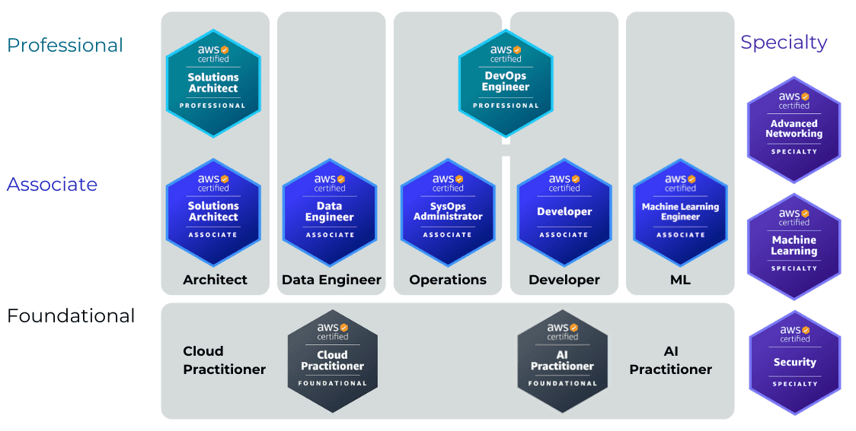
AWS Training

Slide 44
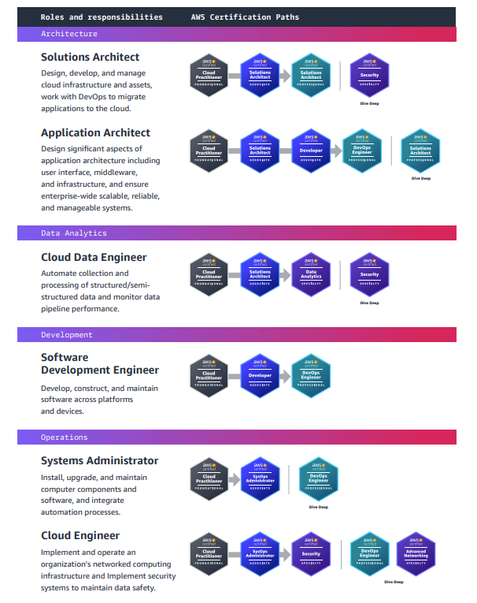
AWS Training
https://miro.medium.com/v2/1*JF2_lFszEiKMH50sX7iPnA.png

Slide 45
CMAC 3990.200
Systems Administration and Operations
Fall 2025 – Week 2.2 – September 4th, 2025
Network & Command Line, Cloud Intro
Domain Name Systems

Slide 46

Assignment Reviews
SSH Tunnel Example and Usage
Assignment 1 Review
  Review of basics
  Recap from 325

Slide 47
Assignment Documentation Expectations
Documentation expectations examples:
  Edit the network configuration file /etc/sysconfig/network-scripts/ifcfg-bond0
    Updated the following information in the network configuration file:
      IPADDR=147.64.243.115
      HOSTMASK=255.255.254.0
      DNS1=147.64.242.100
      DNS2=147.64.242.101
  Restarted the network services to apply configuration changes
      systemctl restart network
  Added entry to /etc/fstab file for persistent disk mount
    147.64.243.115:/data /data nfs bg,rw,sync,hard,intr 0 0
  Updated and rebooted the system
      yum –y update; reboot
  Any additional descriptions that may be helpful!

Slide 48
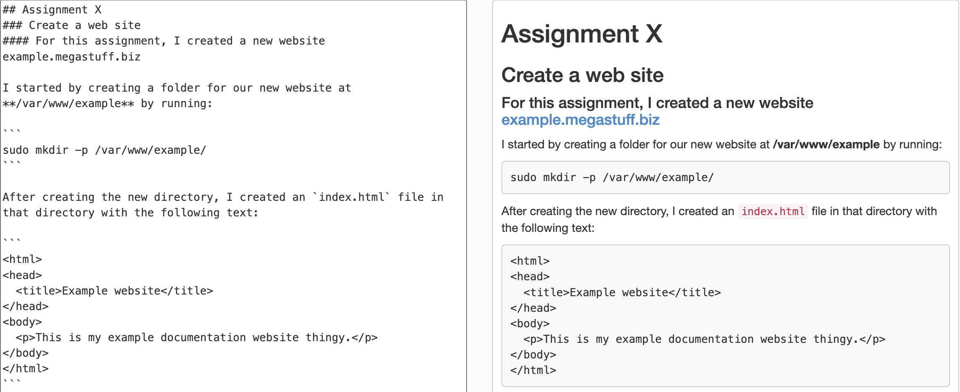
Documentation Options Example…
Markdown – StackEdit.io

Slide 49
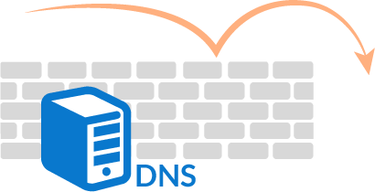
DNS Transaction Example 1
DNS Record: www.eupcs.org
dig ns
dig ns org @a.root-servers.net
dig ns eupcs.org @a0.org.afilias-nst.info
dig a www.eupcs.org @ns1.eupcs.org

Slide 50
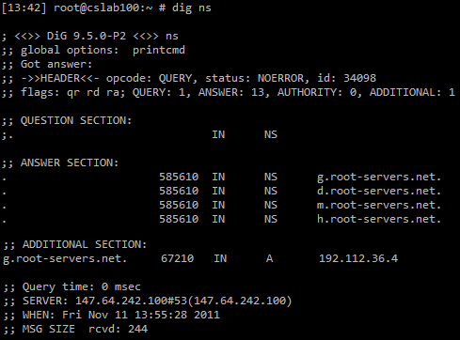
dig ns

Slide 51
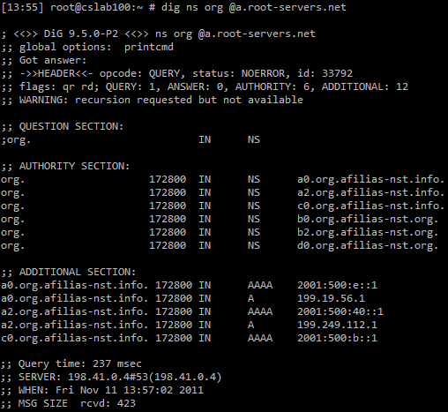
dig ns org @a.root-servers.net

Slide 52
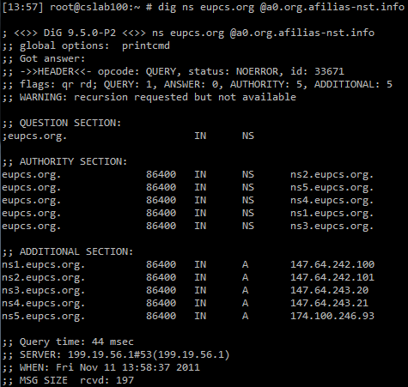
dig ns eupcs.org @a0.org.afilias-nst.info

Slide 53
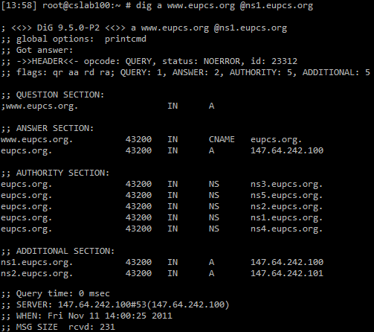
dig a www.eupcs.org @ns1.eupcs.org

Slide 54
DNS Transaction Example 2
DNS Record: www.pennwest.edu
Lookup from cs.Edinboro.edu network
dig ns . @cslab100.cs.Edinboro.edu
dig ns edu @a.root-servers.net
dig ns pennwest.edu @a.edu-servers.net
dig a www.pennwest.edu @mlapp031.calu.edu
  Err… it works?!

Slide 55
RDNS Transaction
Reverse DNS Transaction – IP: 147.64.242.100
RDNS Record: 100.242.64.147.in-addr.arpa
dig ns
dig ns arpa @a.root-servers.net
dig ns in-addr.arpa @a.in-addr-servers.arpa
dig ns 147.in-addr.arpa @a.in-addr-servers.arpa
dig ns 64.147.in-addr.arpa @a.in-addr-servers.arpa
dig ns 242.64.147.in-addr.arpa @edinborodc01.edinboro.edu
dig ptr 100.242.64.147.in-addr.arpa @ns1.cs.edinboro.edu

Slide 56
Recursive vs. Non-Recursive
A recursive DNS server will respond to any DNS query with a non-authoritative answer
  [14:11] root@cslab100:~ # nslookup yahoo.com google-public-dns-a.google.com
  Server: 8.8.8.8
  Address: 8.8.8.8#53
  Non-authoritative answer:
  Name: yahoo.com
  Address: 98.139.180.149
Notes:
DDOS against recursive servers

Slide 57
Recursive vs. Non-Recursive
A non-recursive DNS server will only respond to a DNS query for a zone it is authoritative for
  [15:54] root@cslab100:~ # nslookup yahoo.com ns1.google.com
  Server: ns1.google.com
  Address: 216.239.32.10#53
  ** server can't find yahoo.com.cs.edinboro.edu: REFUSED
Notes:
DDOS against recursive servers

Slide 58
Whois Records
More detailed information specifically about the domain
whois eupcs.org
  Registrant ID:CR36875534
  Registrant Name:Jason Patalon
  Registrant Organization:Edinboro University Computer Science Club
  Registrant Street1:Doucette Hall Room 200
  Registrant Street2:215 Meadville St.
  Registrant Street3:
  Registrant City:Edinboro
  Registrant State/Province:Pennsylvania
  Registrant Postal Code:16444
  Registrant Country:US
  Registrant Phone:+1.8147322000
  Registrant Phone Ext.:
  Registrant FAX:
  Registrant FAX Ext.:
  Registrant Email:jpatalon@edinboro.edu

Slide 59
DNS Records
Megastuff.biz NS record
  megastuff.biz. IN NS ns-cloud-c1.googledomains.com.
Megastuff.biz A/AAAA record
  megastuff.biz. IN A 167.88.8.165
  megastuff.biz. IN AAAA 2600:3c03::f03c:91ff:fe93:f617
4115.megastuff.biz NS record
  4115megastuff.biz. IN NS 4115.megastuff.biz.
4115.megastuff.biz A record
  4115.megastuff.biz. IN A 147.64.243.115
These are the glue records at the megastuff.biz domain, for the 4115.megastuff.biz domain

Slide 60
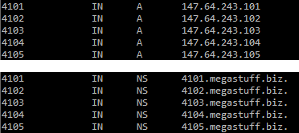
DNS Records
Everyone has NS and A records at megastuff.biz (glue records)
41##.megastuff.biz
  A: 147.64.243.1##
  NS: 41##.megastuff.biz
Ex: 4101.megastuff.biz
  A: 147.64.243.101
  NS: 4101.megastuff.biz

Slide 61
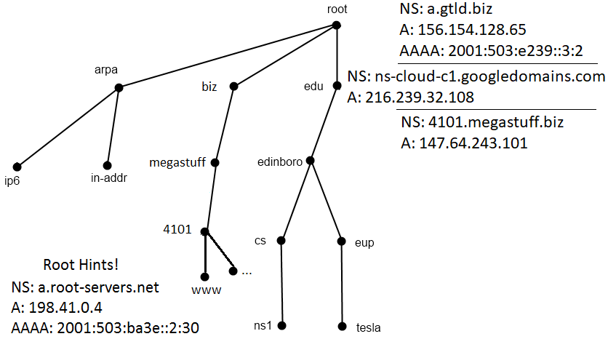
Glue Records – megastuff.biz
Glue records are copies of
NS, A, AAAA
records at parent !
Notes:
13 Root nameservers maintainers, such as verisign, nasa & U of Maryland
259 total root servers (as of 11/30/11)
273 TLD’s
63 characters per level
127 levels max
253 characters per FQDN

Slide 62

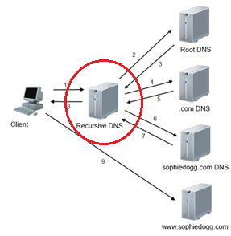
DNS Installation
Install necessary packages
  dnf install bind bind-utils
Put your servers IP address in the bind configuration file /etc/named.conf
  Set your server to listen on any IP address:
    listen-on port 53 { any; };
    listen-on-v6 port 53 { any; };
Allow any machine to perform a DNS query against your server:
  allow-query { any; };
Change the dns-sec validation
  dnssec-validation no;
Notes:
You can now perform a DNS query against your localhost
nslookup megastuff.biz localhost

Slide 63
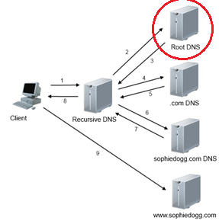
DNS Installation
Recursive name servers need to know the IP addresses of the root DNS servers
  This information is stored in /var/named/named.ca
  Contains NS, A, and AAAA records of root nameservers
      . 518400 IN NS a.root-servers.net.
      . 518400 IN NS b.root-servers.net.
      . 518400 IN NS c.root-servers.net.
      a.root-servers.net. 3600000 IN A 198.41.0.4
      a.root-servers.net. 3600000 IN AAAA 2001:503:ba3e::2:30
      b.root-servers.net. 3600000 IN A 192.228.79.201
      c.root-servers.net. 3600000 IN A 192.33.4.12
  These root DNS server records may change from time to time,
  and need to be kept up to date!
    This information is referred to as “root hints”
    Necessary for proper recursive DNS functionality
    dig ns . @a.root-servers.net +tcp +norec +bufsize=1200
      Output from the above command can be stored in /var/named/named.ca
Notes:
This dig command will produce a current list of root nameservers that can be copied directly into the /var/named/named.ca file
dig ns . @a.root-servers.net +tcp +norec +bufsize=1200

Slide 64
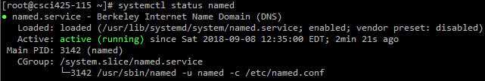
DNS Installation
We now have a recursive caching DNS server!
Start the service
  systemctl start named
Enable the service to start on boot
  systemctl enable named
Check that the service is running
  systemctl status named
Notes:
You can now perform a DNS query against your localhost
nslookup megastuff.biz localhost

Slide 65
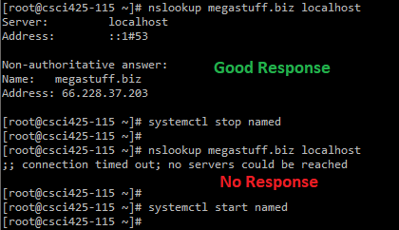
DNS Installation
Check status of service
  systemctl status named
Validate local server operation
  Do an nslookup against your machine locally of megastuff.biz
    nslookup megastuff.biz localhost
  Stop the named service & do another lookup
    systemctl stop named
    nslookup megastuff.biz localhost
    This lookup should fail!
  Start named service back up
    systemctl start named

Slide 66
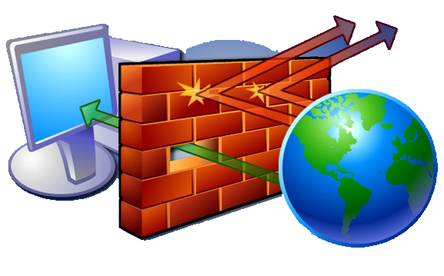
DNS Installation
Firewall is blocking DNS requests from other machines
Allow DNS requests through firewall
  DNS can use both TCP and UDP ports 53, add a firewall rule for to allow both
    firewall-cmd --zone=public --add-port=53/tcp --permanent
    firewall-cmd --zone=public --add-port=53/udp --permanent
    firewall-cmd --reload
At this point, professor and other students should be able to
perform DNS queries against your name server!
  University firewall prevents direct off-campus connections!
  Try to do an nslookup against your server from jason88
    nslookup megastuff.biz 147.64.243.1##

Slide 67
DNS Installation
The nameservices for the 41##.megastuff.biz domains are delegated to each machine
We need to create entries for our name server
Add the following to the end of your /etc/named.conf file
    zone "41##.megastuff.biz" {
    type master;
    file "/var/named/41##.megastuff.biz.hosts";
    };
This defines our server as a master for the specified zone
We can potentially define slave/secondary servers here
These 41##.megastuff.biz addresses won’t resolve normally, until your DNS server is working!

Slide 68
DNS Installation
Create our /var/named/41##.megastuff.biz.hosts hosts file:
Make sure to replace all instances of ## with your 2-digit VM number!
Restart named service afterwards!
  systemctl restart named
$ORIGIN 41##.megastuff.biz.
$TTL 43200 ; 12 hours
@ IN SOA 41##.megastuff.biz. admin41##.megastuff.biz. (
2018090101 ; serial
21600 ; refresh (6 hours)
600 ; retry (10 minutes)
1209600 ; expire (2 weeks)
10800 ) ; minimum (3 hours)
IN NS 41##.megastuff.biz.
IN A 147.64.243.1##
www IN CNAME 41##.megastuff.biz.

Slide 69
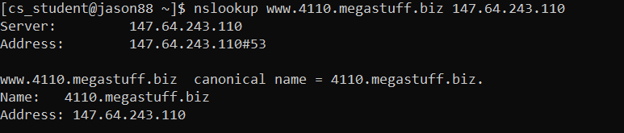
DNS Installation
Validate that you can lookup your www.41##.megastuff.biz record from your machine
and from another machine!
  nslookup www.41##.megastuff.biz 147.64.243.1##

Slide 70
DNS Installation
Add a new record in our /var/named/41##.megastuff.biz.hosts hosts file:
Make sure to replace all instances of ## with your 2-digit VM number!
Restart named service afterwards!
  systemctl restart named
$ORIGIN 41##.megastuff.biz.
$TTL 43200 ; 12 hours
@ IN SOA 41##.megastuff.biz. admin41##.megastuff.biz. (
2018090101 ; serial
21600 ; refresh (6 hours)
600 ; retry (10 minutes)
1209600 ; expire (2 weeks)
10800 ) ; minimum (3 hours)
IN NS 41##.megastuff.biz.
IN A 147.64.243.1##
www IN CNAME 41##.megastuff.biz.
a3 IN A 147.64.243.1##
Add →

Slide 71
DNS Installation
Only allow recursive DNS queries for specific clients and set a version!
  Remove (comment out) the line that says “recursion yes;”
  Add allow recursion configuration (within main options section):
      allow-recursion {
      127.0.0.1;
      ::1;
      147.64.243.96/27;
      };
  Add a version line! (within main options section)
    DNS server version information can expose security vulnerabilities!
        version “cmac3990.1##";
    Check your version from the command line!
        dig version.bind txt chaos @147.64.243.1##
/etc/named.conf file

Slide 72
DNS Checks
Dnsstuff.com
Intodns.com
  Checks a variety of DNS settings
  https://www.intodns.com/eupcs.org
  https://www.intodns.com/mtsd.org
  https://www.intodns.com/edinboro.edu
  https://www.intodns.com/megastuff.biz

Slide 73
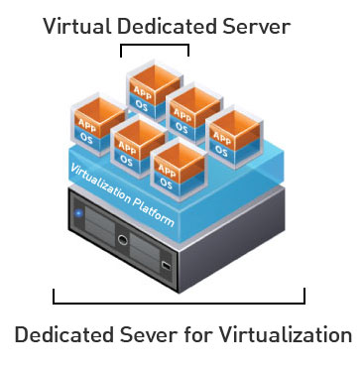
Virtual Machines
IP Address: 147.64.243.1## (01-25)
Hostname: cmac3990-1##.cs.edinboro.edu (01-25)
Alias: 41##.megastuff.biz (01-25)
Assignment 3 tasks covers initial DNS server configurations
  Uses commands discussed during class
  Configure recursive and authoritative DNS server
  Due September 12th – run check script
    https://jpatalon.cs.edinboro.edu/cmac3990/classfiles/assignment3check.sh
  Don’t forget the documentation!

Slide 74
Linux Commands
dig
nslookup
whois
yum
firewall-cmd
reboot
shutdown
systemctl enable
systemctl start
systemctl stop
systemctl restart

Slide 75

Key Terms and Items
SSH Tunnel
Domain Name System
Namserver Types
  Master, slave, root, recursive, stealth, TLD, etc.
Time To Live
Fully Qualified Domain Name
DNS records
  A, AAAA, NS, MX, SOA, etc.
Glue records
DNS Transaction
  Forward and reverse!
WHOIS records
DNS Server Best Practices
BIND
Root Hints
DNS Server Installation
DNS Checks

Slide 76

For Next Week
“The secret for success is to be ready when the time comes.” –Benjamin Disraeli (adapted)
Homework Assignment 3 – Due September 12th, 2025
Textbook:
  Chapter 6: Software Installation
  Chapter 7: Scripting
  Chapter 8: User Management
Network Hardware
Samba
Obtaining a Domain
Continuing to work with VM’s
  Cloud, Printers, LDAP, SMB, NTP…

